Slide 1
Virtual Library Tech Talk
Grant Saylor, Kyle Smith, Anthony Tran, Jiayi Xu

Slide 2
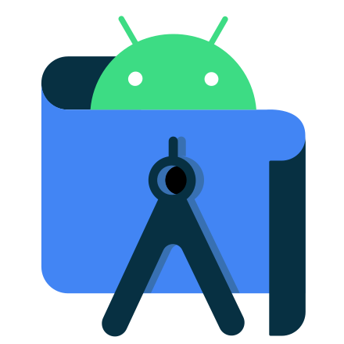

Grant
Android Studio GitHub Integration
+
Speaker: Grant Saylor
Topic: Android Studio GitHub Integration
Notes:
Hi everyone, I’m Grant Saylor and I’m here to talk about the integration of GitHub and Android Studio. <Click Slide>
Android Studio is a powerful integrated development environment that is used to write Android applications, as you’ll see in our presentation there are many integrations and features that we have found helpful for our capstone project.

Slide 3

Grant
Git and GitHub
Git is the version controller (VCS)
GitHub is where its stored into the cloud
Typically accessed via a command line interface
Notes:
Many of us utilize GitHub to host our projects for version controlling. Typically, GitHub is accessed via Git on the command line.
Git is a version control system to track changes in your source code during the development of your application and GitHub is where it’s all stored in the cloud for access

Slide 4
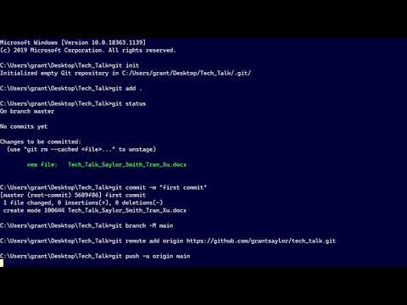
Grant
The Command Line Interface
Fantastic knowledge to possess, however requires potentially arcane invocations to perform a task
Notes:
As you’re going to be seeing in this video, versioning your files on the command line requires a sometime arcane knowledge to invoke a specific task. <Play video> The command line is fine and perfectly usable and utilizing the command line for Git is knowledge that is you should know.

Slide 5
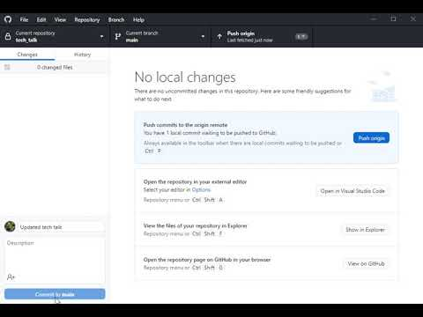
Grant
The Graphical User Interface
Performs all the tasks of the command line, but in a more user friendly approach.
Great for large group projects to avoid a potential disaster
Notes:
In this next video you’ll see a graphical user interface of the same function. <show video of GitHub app> There can be times, such as when a project is large and developed by many where a graphical user interface is preferable, such as the GitHub app.
This does all of the same functions as the command line just with a user interface. It is particularly good for avoiding large scale disasters due to it all being presented in an easy to manage form.

Slide 6
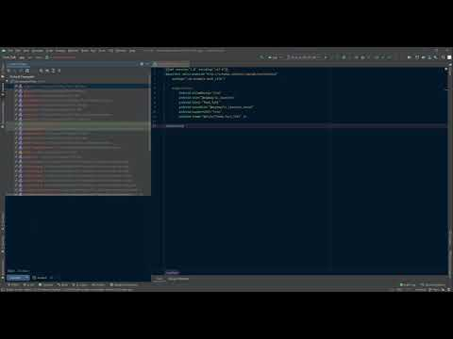
Grant
The Power of GitHub and Android Studio Together
Control your versioning from within
Android Studio
Utilize a GUI for easy workflow
As you saw, from the toolbar you can access every Git command, from pushing to pulling and more.
Notes:
I’d like to highlight how Android Studio pulls the power of GitHub and integrates it directly in to the IDE. For our project, Virtual Library, we are utilizing the Android Studio IDE as our development environment.
Android Studio has the ability to utilize GitHub from within the IDE in the form of a graphical user interface, this allows quick access and keeps a constant workflow. <Show video>
You can see here that the actions performed are very similar to the GitHub desktop app, just within the IDE. The Android Studio toolbar allows access to every Git command, from pushing to pulling and more.

Slide 7

Grant
What’s the Catch?
Android Studio and GitHub can both be free!
Notes:
The great thing about Android Studio is that it’s a free tool and so are its version controlling features.
Some IDEs may require a higher paid tier account to gain access to certain features, like version controlling, but with Android Studio it is included in the box.
To utilize the feature, you will just need to create GitHub account and connect your local repository to the remote repo.
The great thing about GitHub is that it can also be free, you dont need to pay extra for it unless you want some extra features.

Slide 8
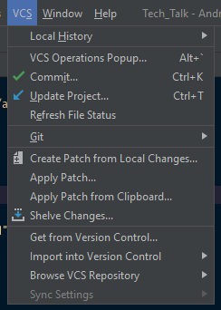
Grant
Some Additional Features
Android Studio allows much more than push and pull
An integrated GUI for VCS allows a continuous workflow
Notes:
Speaking of extra features, Android Studio allows you to do more than just pushing and pulling. In addition to push/pull, you can also shelve changes, refresh the status of files, browse the local history of the files.
All these features together allow you to have a continuous workflow without breaking up the work by switching to and from a command line or outside GUI. Pictured in this screenshot is how to access all of your VCS from within the toolbar in Android Studio.

Slide 9
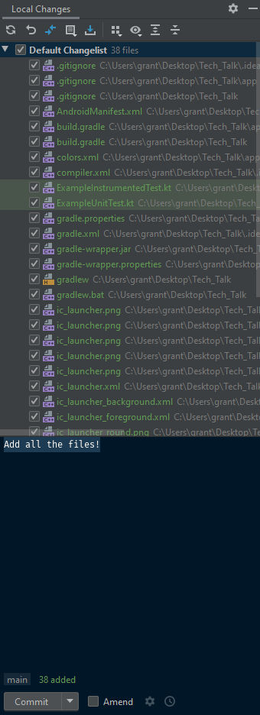
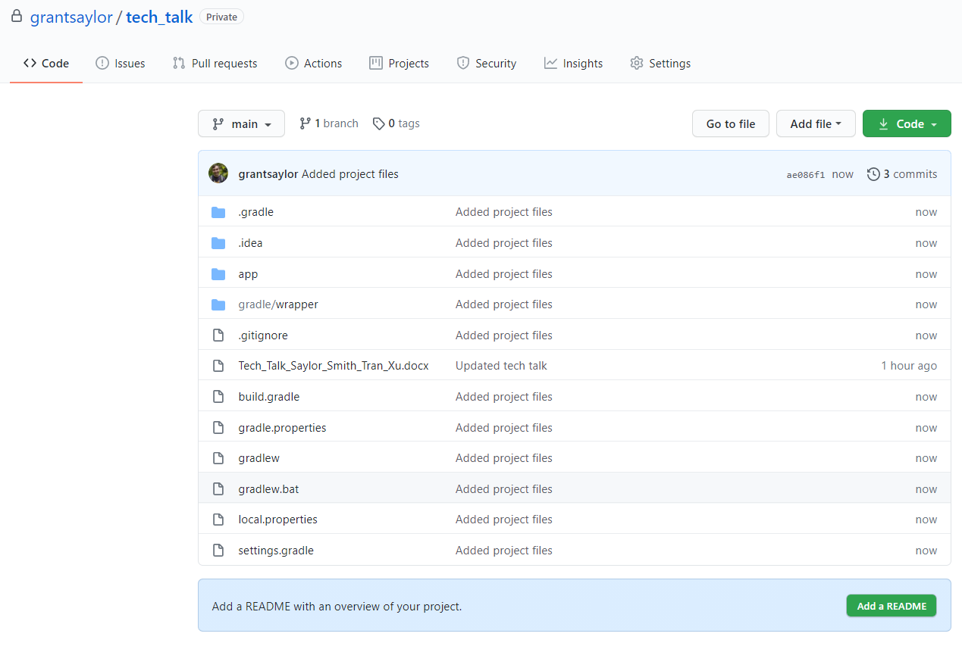
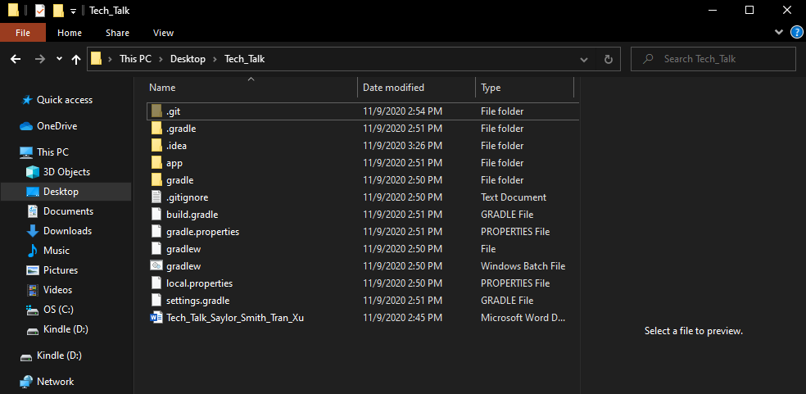
Grant
Version Controlling In General
Version Controlling is great!
Imagine sharing information with your groupmates manually… VCS makes it easy to share
Notes:
These version control systems are included in the IDE for a reason, it’s extremely important to the development of your application.
As you can see in this diagram, the local files in my file system are then marked by the Android Studio VCS as files to be added to my Git repository, by then committing and pushing it will show up in my remote repository in the cloud.
From there my groupmates can access these files and pull them to their local system.
We’ve found that with our newly remote work habits due to COVID-19, having a remote repository is vital to the development of our capstone project, without it, sharing our source code would be very difficult, and really this is going to apply in the real world as well.

Slide 10
Grant
How Android Studio Makes VCS Easier
Take a look at these diagrams to see the workflow...
With Android Studio
Without Android Studio
Elegant and Simple
Clunky and Time Consuming
Notes:
Android Studio really does make VCS easier. As you can see in these two mini demos, on the left, with Android Studio there is never a break from the IDE and everything is handled in less than a minute.
On the right, without using Android Studio there is a much longer process that requires a lot of typing, window switching and overall distraction from your project.
The integration in the IDE itself is very helpful, it’s a feature that Android Studio handles very well.

Slide 11
Grant
Thank you!
Android Studio allows for an elegant implementation of GitHub by placing all components into one area, giving a solid workflow to the developer.
Notes:
Thank you! Really it comes down to that Android Studio provides an elegant solution to version controlling by having it all easily accessible in the IDE. Thank you and I’ll hand it over to my groupmate!

Slide 12


APIs for Virtual Library
RESTful API
Speaker: Kyle Smith
Topic: APIs for Virtual Library

Slide 13
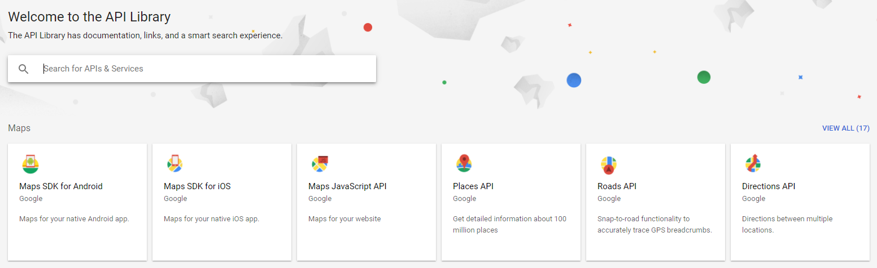
Google Maps Platform

Slide 14
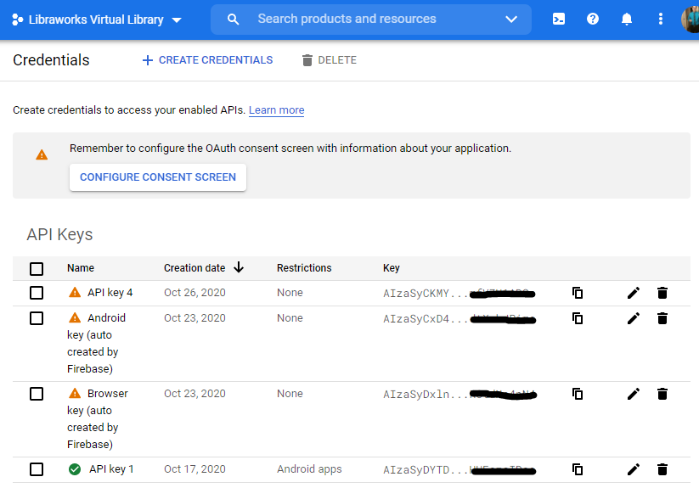
Google Maps API
Acquire a key
Set up a billing plan (small projects are free)
Add your key to your project

Slide 15

Adding Google Maps API Key
Create a file named ‘secure.properties’ in project level directory
Add code to your build.gradle file, in the defaultConfig element.
Add code to your AndroidManifest.xml file, in the application element.
Sync your project with Gradle.
Optional:
Restrict usage of your API key.
Acquire a SHA-1 Fingerprint for your app.

Slide 16
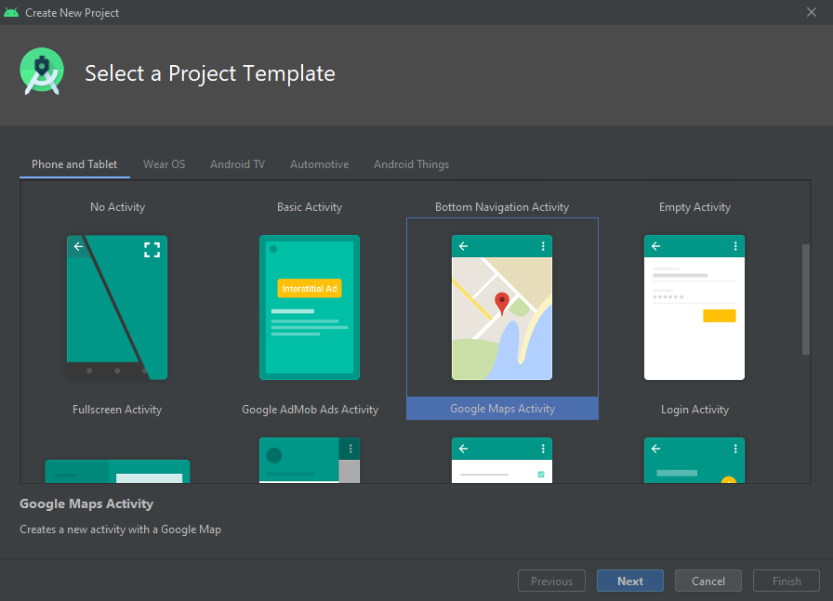
Using the Google Maps API
Now that your application has your API key and required code, you are ready to continue.

Slide 17
Dependencies and Required Code
App needs dependencies and permissions to communicate smoothly with Google Play Services.
App-level build.gradle - implement Google Play Services and GMS location.
AndroidManifest.xml - Ask user for GPS location permission, add code for interaction with the map, and add the API key here as well.
MapsActivity.kt - Written like a classic Java (Kotlin) class, with methods to handle the behavior of the activity.

Slide 18
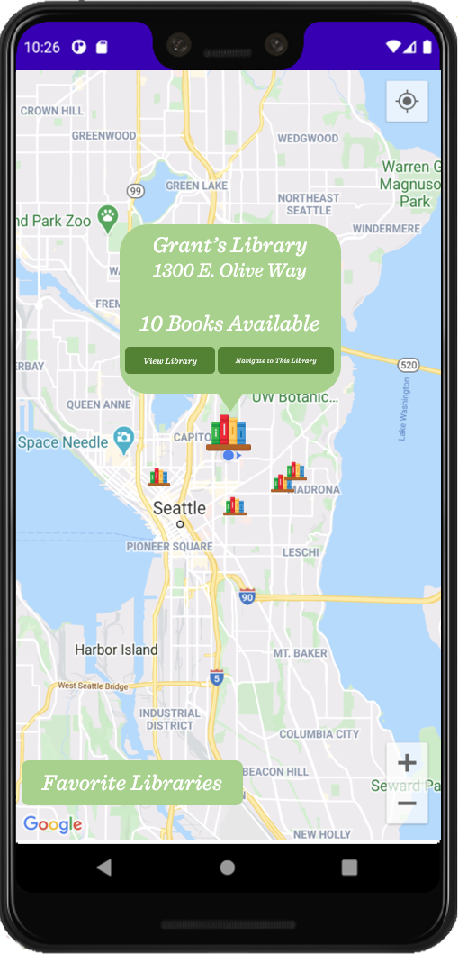
Your map could look like this:
You can use the layout editor to add buttons and change the way the map is presented.
Integrating the Google Places services will allow for custom pins.
Use MapsActivity.kt to add/change functionality of elements

Slide 19
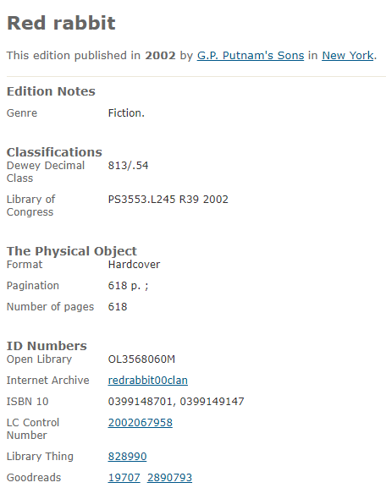
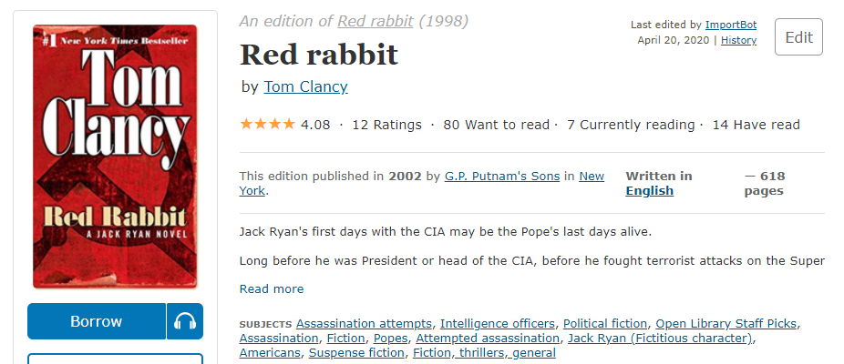
OpenLibrary API
OpenLibrary is a website that is part of the Internet Archive, and stores information about all kinds books.

Slide 20
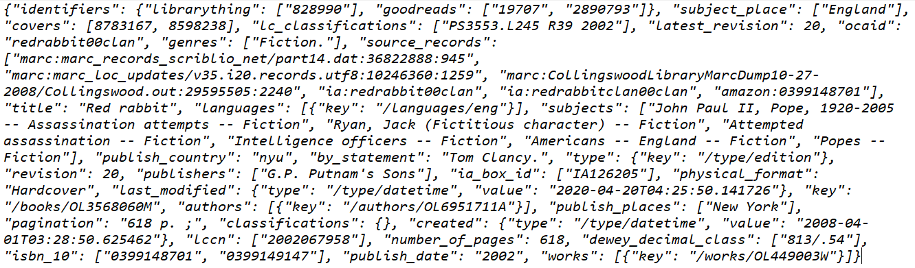
RESTful API
Open Library RESTful API facilitates interactions and handles queries between your app and their site. They can return data on books in a few formats, JSON, YAML and RDF/XML.

Slide 21
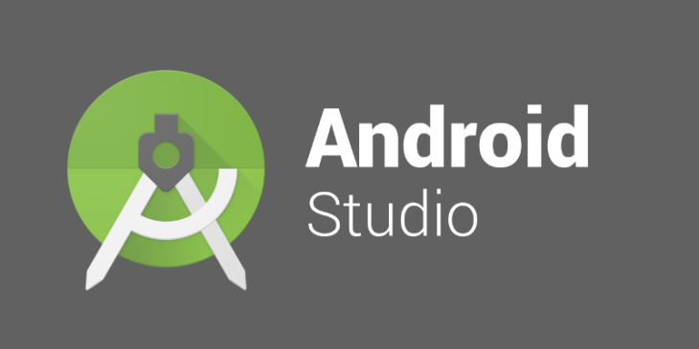

Using Android Studio’s Layout Editor (Visual Editor)
+
Speaker: Anthony Tran
Topic: Android Studio’s Layout Editor

Slide 22
Explain Layout Editor
Android Studio allows programmers to create applications using pre-existing UI elements that comes along with the code that makes up that element. This feature is called Layout Editor
The Layout Editor in Android studio allows users to simultaneously work on Kotlin code while also using the Layout Editor’s convenient interface to help create an application more efficiently
Anything that is changed through the Layout Editor will have the appropriate code added/changed in the Code section of Android Studio

Slide 23
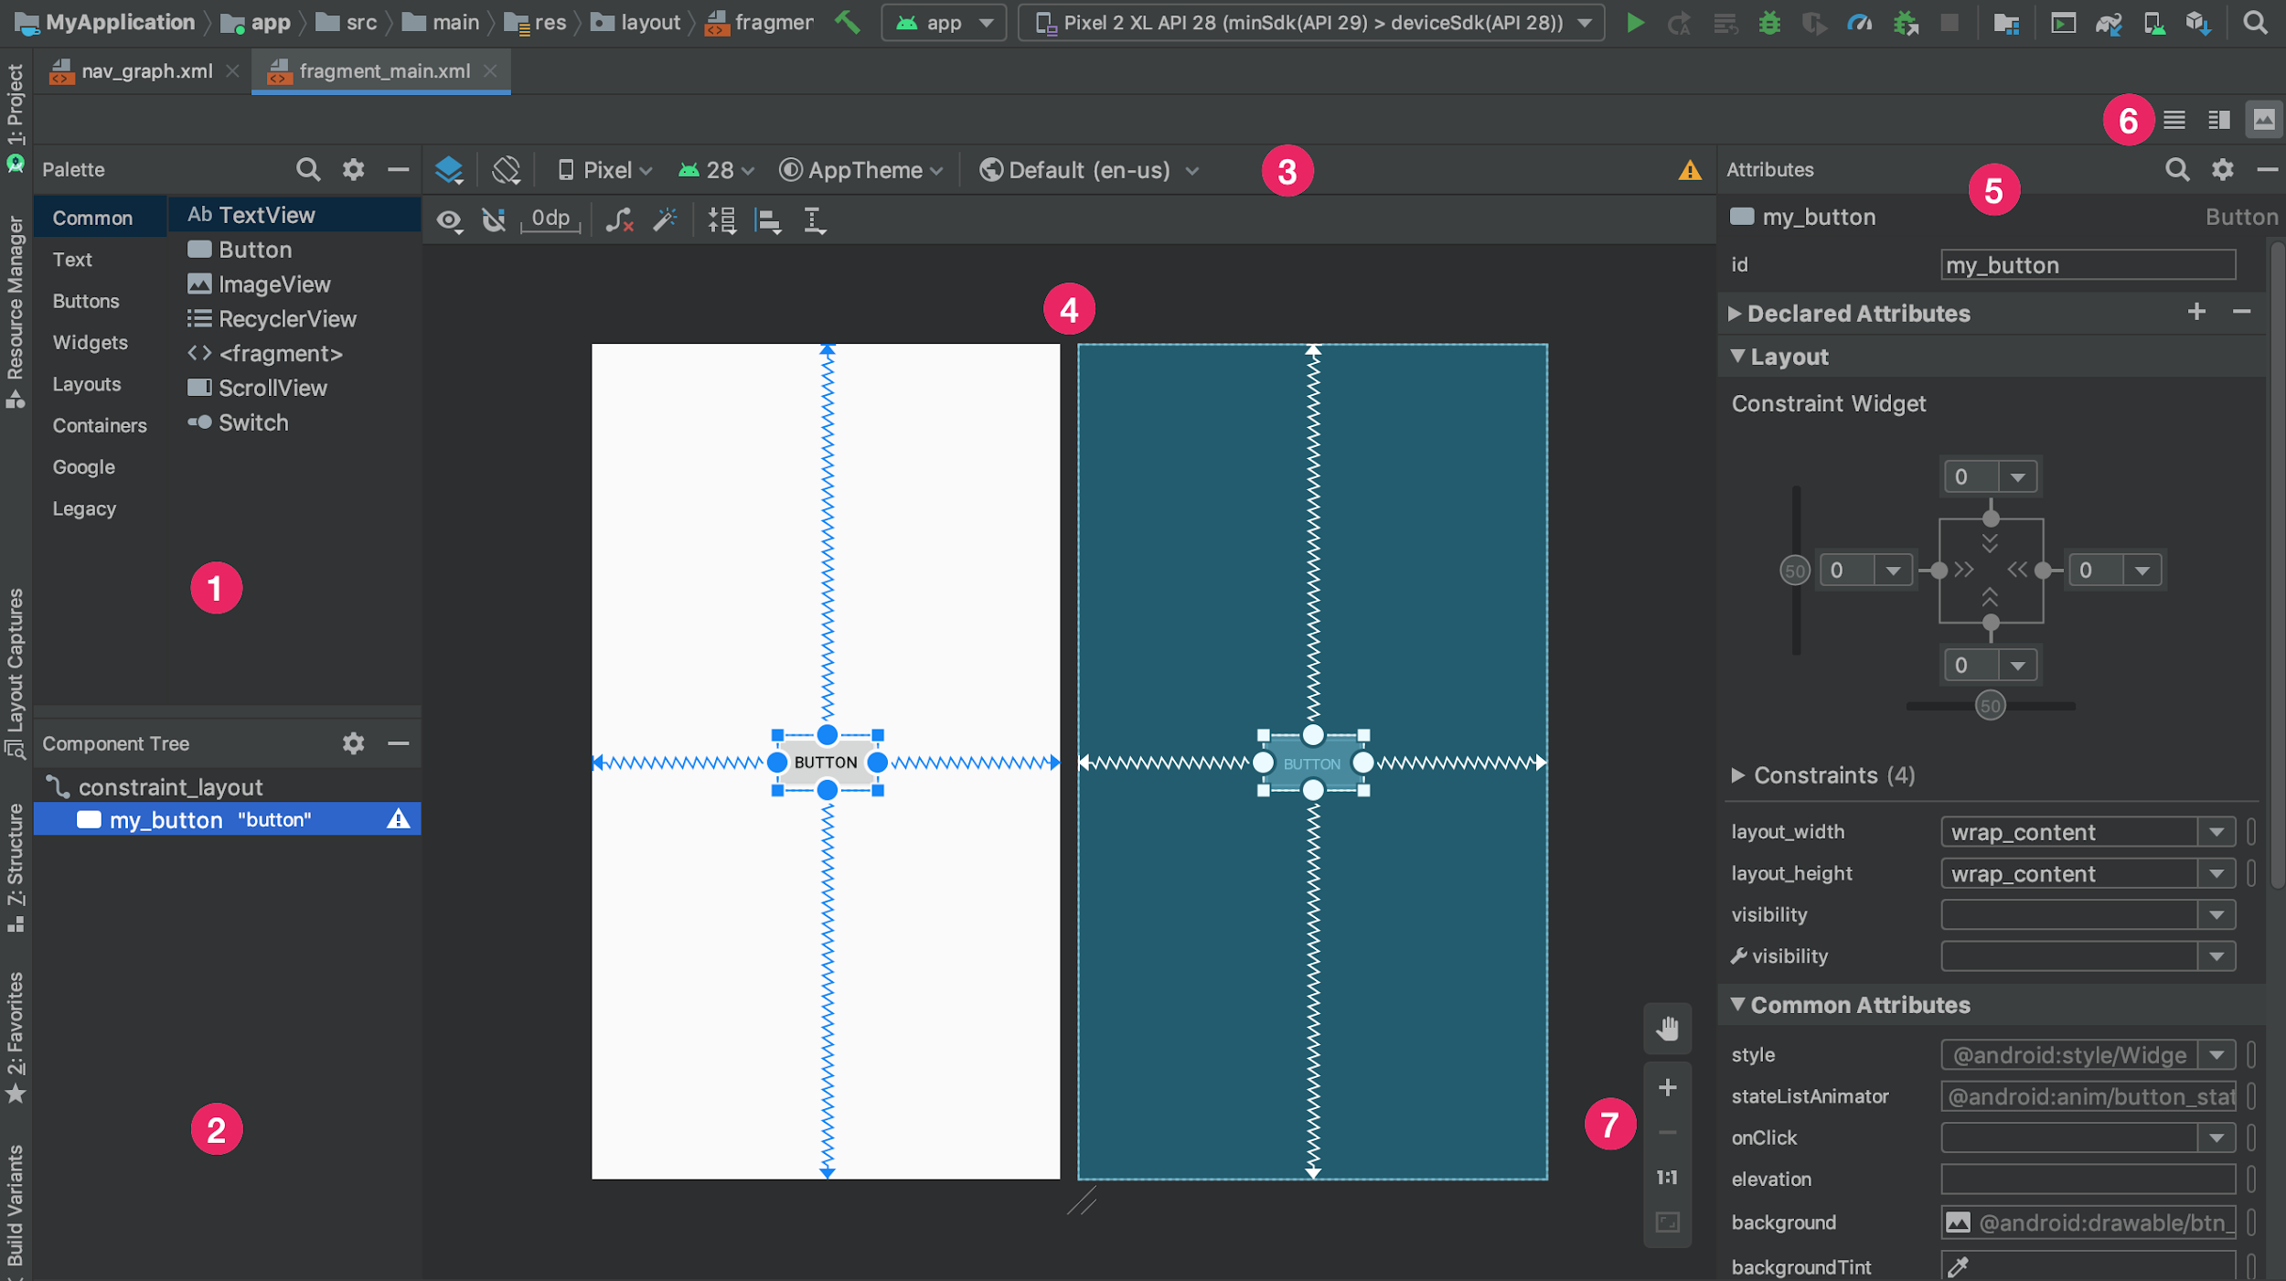
Palette: Contains various views and view groups that you can drag into your layout.
Component Tree: Shows the hierarchy of components in your layout.
Toolbar: Click these buttons to configure your layout appearance in the editor and change layout attributes.
Design editor: Edit your layout in Design view, Blueprint view, or both.
Attributes: Controls for the selected view's attributes.
View Mode: View your layout in either Code, Design, or Split mode
Zoom and pan controls: Control the preview size and position within the editor.

Slide 24
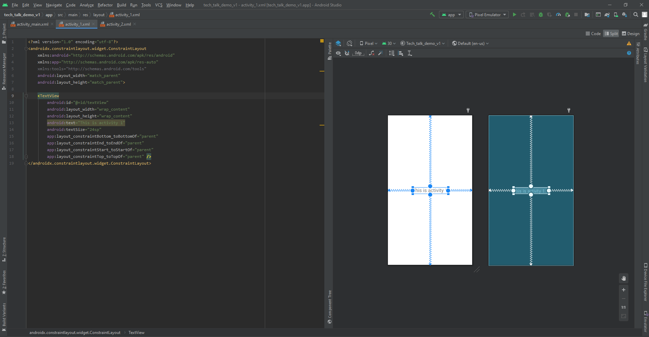
Why Layout Editor is Useful for our Project
Allows us to visually see our application while coding in real time

Slide 25
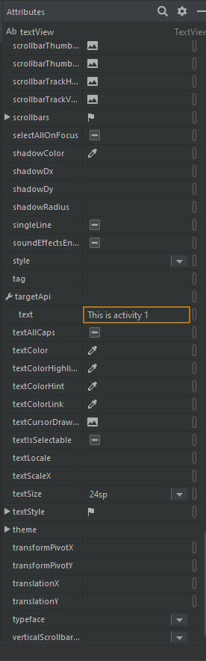
You can manually change variables of elements
On the “Attributes” Section, which will alter the
Code as well.
Alter parameters such as text size, text color,
Button color, etc.

Slide 26
Changing the name of the textView in the attribute sections changes the code on the left

Slide 27
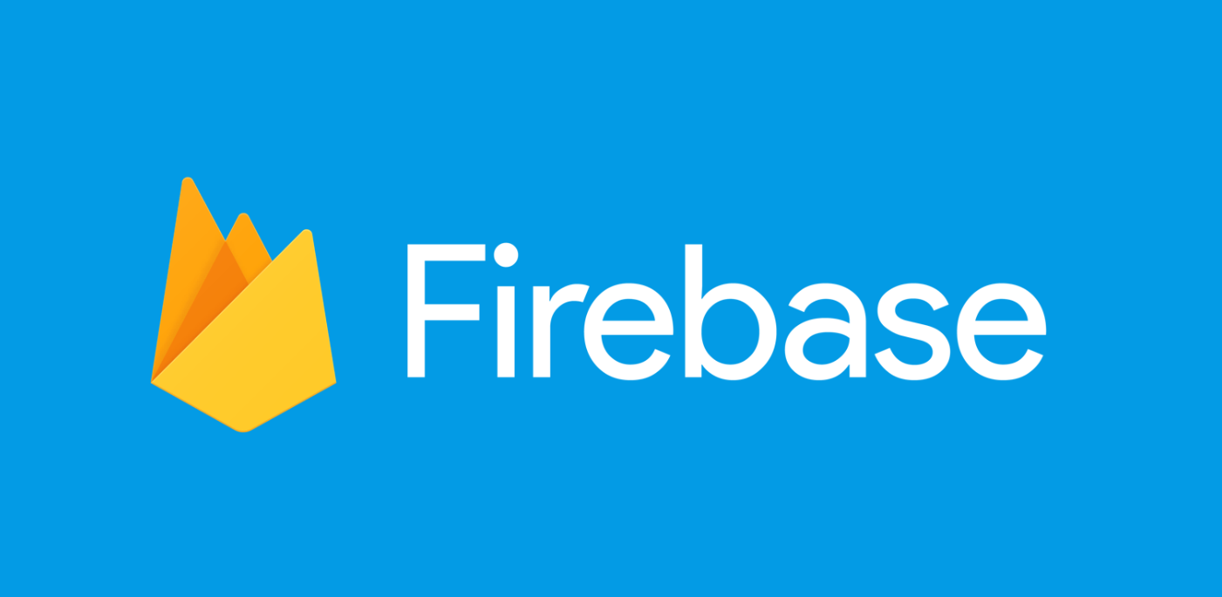
Firebase
Firebase: is an application development
platform designed in particular for mobile app developers.
Include: hosting, authentication, data-driven
Triggers and analytics.
Speaker: Jiayi Xu
Topic: Firebase in Android Studio

Slide 28





Firebase Main Features
…...

Slide 29
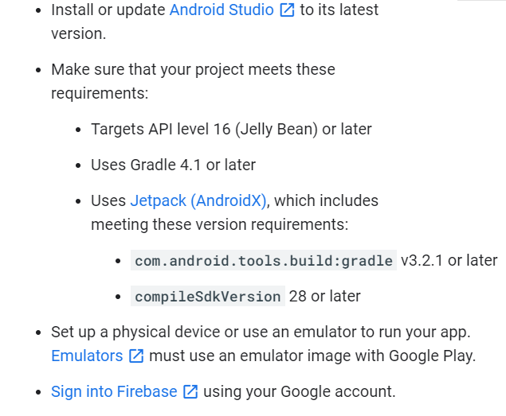
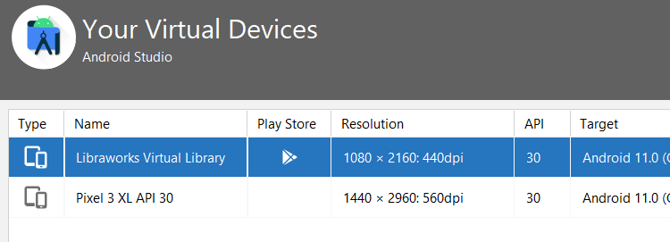
Prerequisites Before Connect To Android Studio
Check “build.gradle(Model: app)”
Check “gradle-wrapper.properties”
Check “gradle.properties” and “build.gradle(Project: )”

Slide 30
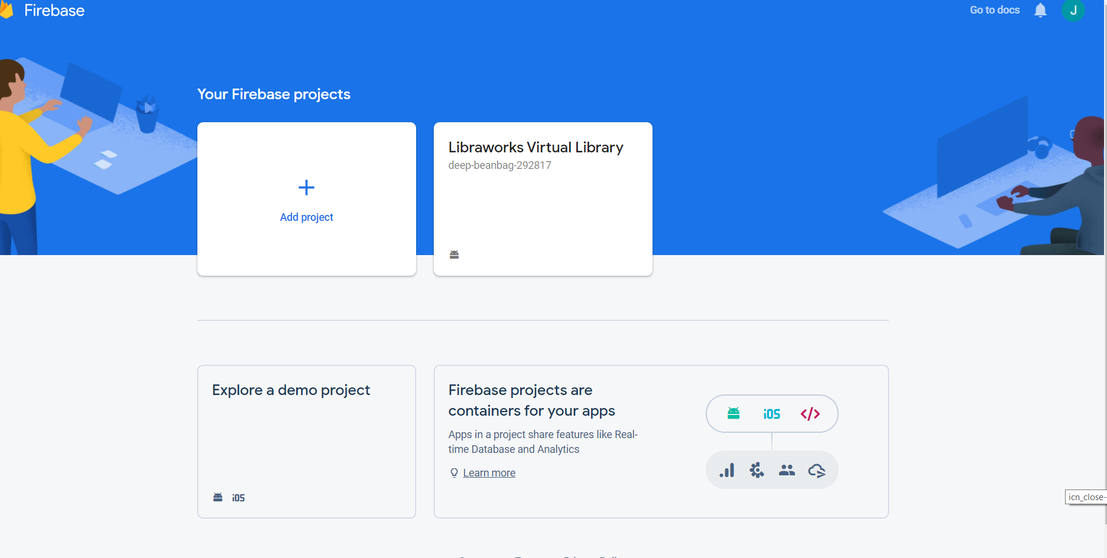
Create new realtime database project

Slide 31
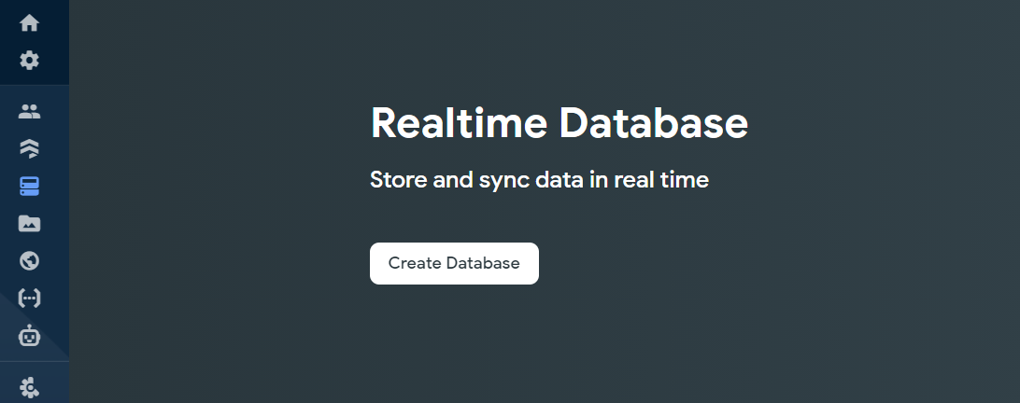
Create a Realtime Database
What is “Realtime Database”?
“The Realtime Database is a NoSQL database and as such has different optimizations and functionality compared to a relational database. The Realtime Database API is designed to only allow operations that can be executed quickly.”
Resource: https://firebase.google.com/docs/database/#:~:text=The%20Realtime%20Database%20is%20a%20NoSQL%20database%20and,only%20allow%20operations%20that%20can%20be%20executed%20quickly.

Slide 32
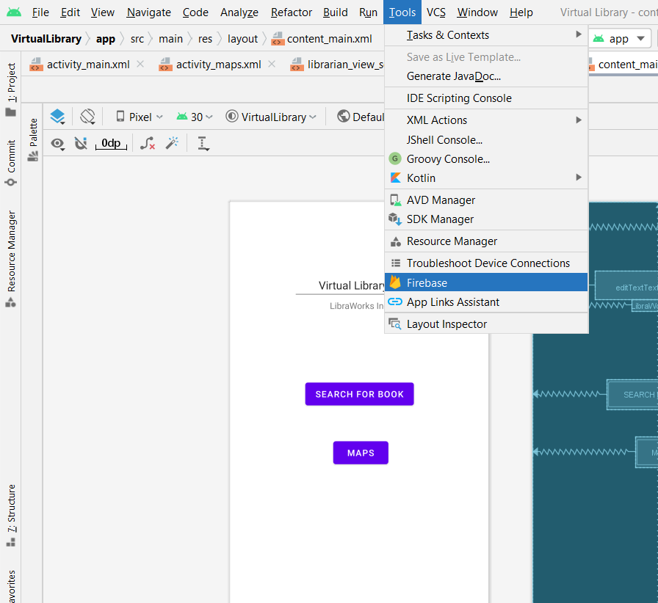
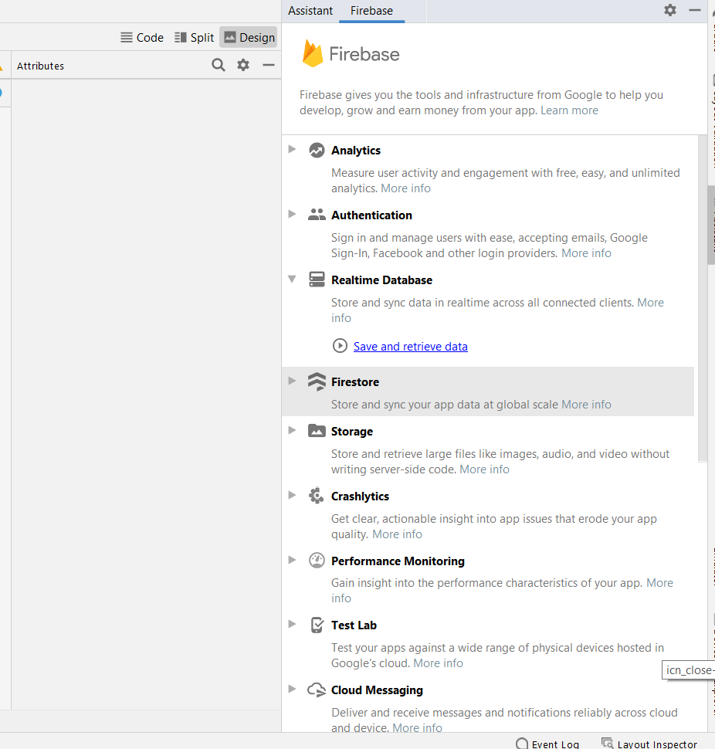
Find “Realtime database”

Slide 33
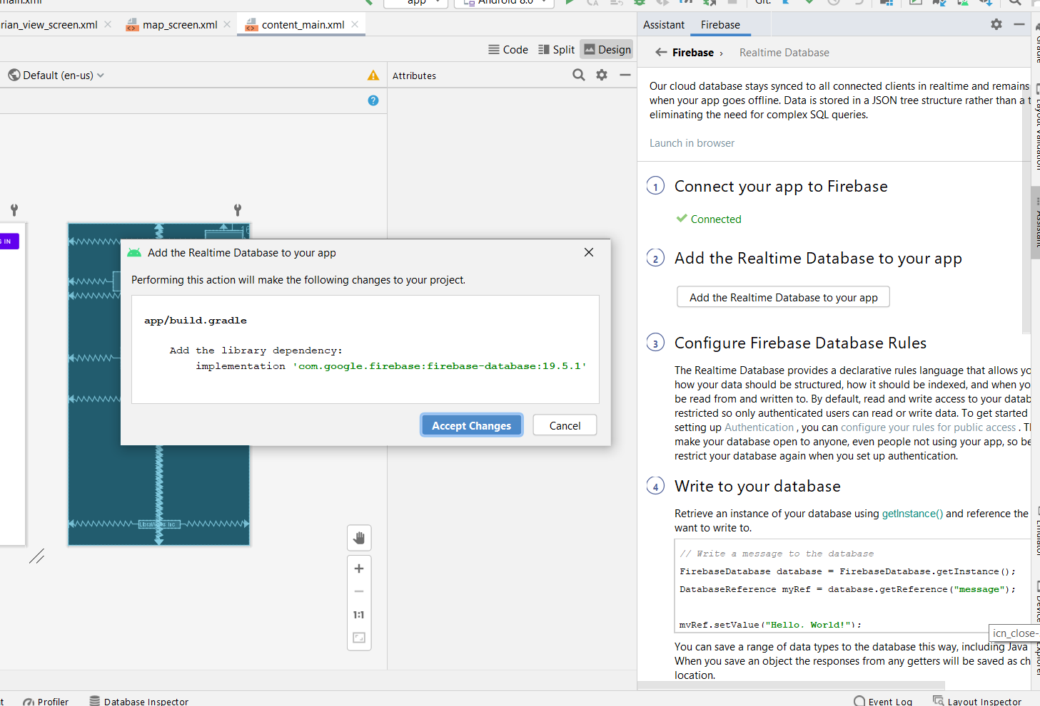
Add realtime database to app
Accept changes will automatically add configure files to your app.

Slide 34
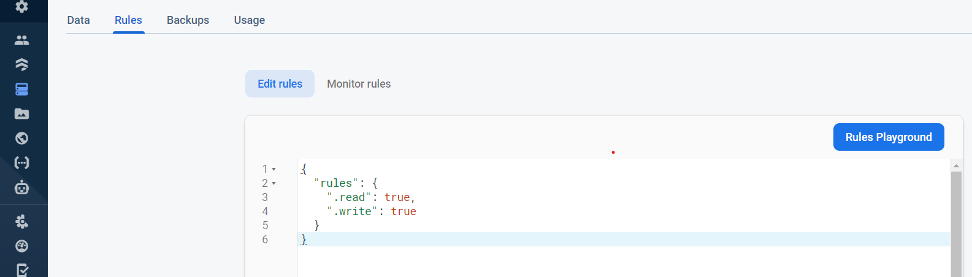
Configure Rules
By default: Only authenticated user can read or write data
To make data open to anyone:
Not Security !
More rules: https://firebasetutorials.com/firebase-realtime-database-rules/

